Slide 1
AMSA Education
Conference & Expo
Todd M. Jensen
Lt Col, United States Air Force
Director, Personal Property

Slide 2
Agenda
Channel Pilot & Federal Register
2015 – 16 Transition
No Refusal Policy
Rate Filing
Peak Season Communications
Quality Assurance
Punitive Actions
Transportation Service Provider Review Board (TRB) Process
Staff Assistance Visit Program
Summary

Slide 3
Channel Pilot
COMMUNICATION!
Understand the environment . . .
Federal Register vs. Informal Communication
Government process to communicate equally/fairly to the public proposed policy/process changes
Theoretical Process:
Federal Register posting: starts process
60 day industry comment period
Comment collection and return to SDDC
SDDC comment review and adjudication
Final rule posting
Moving Forward
Leverage both formal and informal communications
Focus/working groups
Federal Register works!

Slide 4
From 2015 to 2016 . . .
2015 Peak Season “Top Three”
“No shipment refusal” policy brought efficiencies to customer and TSPs handled the difficult transition very well
Use of Code 2 (containerized) was much higher. Services committed to continuing use and search for ways to make use of Code 2 more predictable while increasing capacity at a reasonable cost
Need for installation-level quality assurance oversight and consistent enforcement program-wide
Way ahead for 2016 peak season
Continued dialogue and communication during off peak and peak season 2016
Moved up rate filing 1 month to optimize pre peak season planning for industry and Services
Industry to work with Military Claims Services and SDDC to improve the claims process and look at potentially reviving a “Claims Score” as a component of Best Value Score shipment distribution
No refusals to continue, expand short fuse window determination
Continue to assess measures of program health by monitoring key metrics in 2016
CSS score, RDDs, Offer Handling Time , # Short fuse shipments, use of Code 2 bookings, TSP lead time
Notes:
COVER SLIDE GUIDELINES:
Type the title of your briefing where indicated. Titles on the cover slide will be in Arial font, Bolded, size 40 point, centered if possible, see note below.
Type name of briefer in middle & center (if known or if appropriate for the audience)
Type the date of the briefing under briefer name.
NOTE: If the text looks off center or doesn’t fit properly because the title or the name of the briefer is too long, then left justify
GUIDELINES FOR BRIEFING SLIDES:
Slide titles will be in Arial font, Bolded, size 36
Sub-headings, if used will be in Arial font, Bolded, size 24 point
Use the bullet format preset on the slide template.
Text on the slide will be in Arial font, preferred size is 20. Size the font appropriately keeping in mind the audience and the setting for the brief. Text should be black.
CG's NEW GUIDELINES FOR CREATING BRIEFINGS:
Keep them black and white, concise, and free of clutter. CG is a BLUF (Bottom Line Up Front) leader.
Keep future presentations/briefs to no more than five slides.
Highlight a few areas and emphasize your key points/intended takeaways.
Unless a picture serves an explicit purpose, don’t use them.
When briefing, do not read the chart.

Slide 5
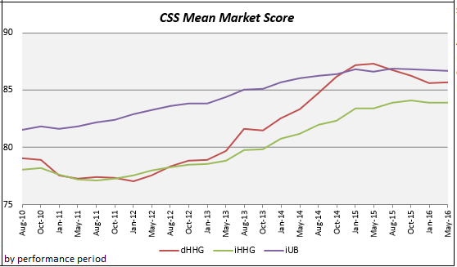
No Refusal Policy
Decreased offer handling time
Virtual cessation of refusals
Increased TSP lead time
Below average number of short fuse shipments
Inconclusive CSS effects
Decline started with scores for 1 June 14 – 31 May 15 (Aug period)

Slide 6
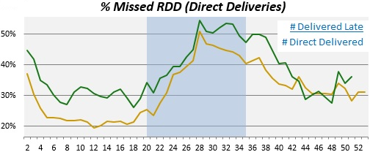
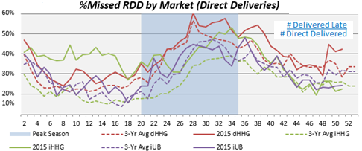
No Refusal Policy
Missed RDDs
Little to no effect on RDDs
Concluding thoughts
Rate filing consideration
Blackout experience
Hard to service areas
Continue to evaluate
Notes:
Shipments with Pickup Dates Jun14 – 8 Jun 15

Slide 7
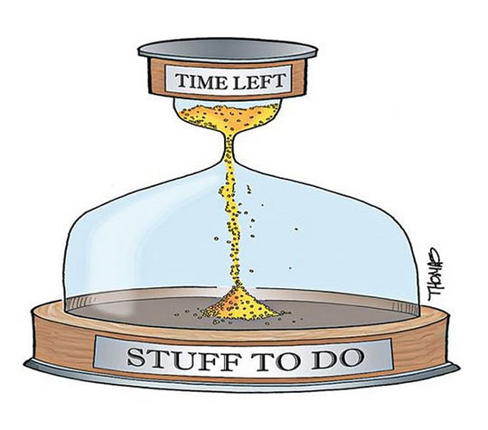
2016 Rate Filing AAR
Timeline
Earlier start than previous years
Round 1 Dates 10 Jan – 20 Jan
Round 2 Dates 15 Feb- 22 Feb
What worked
RFQ Workbench
Rankings available for TSP review for 3^{1/2} days
Backlog reports provided several weeks out
TDL “live” 9 March with under 3,500 shipments
in queue
Issues and concerns
Multiple starts/stops with Round 2
System Problem Reports 7417 and 7609, impacts suspended TSPs
Database scripts and review process
Impact of releases
Notes:
Additional Rate Filing Improvements PEO-T indicates we’ll need to submit to the FRB
SCR TBD Daily Rate Filing Report Format Change
SCR TBD Unable to review CRs after R1
SCR TBD Screen Refresh Required to see BRF changes in WB
SCR TBD Workbench Design Changes
SCR TBD User Interface for Competitive Ranges
SCR TBD User Interface for International Tender Reference Data
SCR TBD User Interface for 400NG Tariff Reference Data
SCR TBD User Interface for Channel Control Listing
SCR 588 Need indicator if a TSP has not filed rates for

Slide 8
Peak Season Message
Time sensitive info
TDL availability (9 March)
No refusals/short fuse expansion
Communication
PCS Week
Weekly calls (off peak 31 Mar, weekly 28 Apr)
Peak Season Tools
Code 2/DPM
Blackouts/PPSO “no capacity” report
Short fuse expansion/SIT at Origin
Volume Moves
Counseling
Quality Assurance
Turnbacks/Refusals
Missed RDDs & Inconvenience Claims
Storage in Transit Management
Payment for SIT (Origin vs. Destination)
Reweighs
Containerized, non-containerized
Notes:
Table of Contents for the Peak Message. Will have printout available and details to respond accordingly

Slide 9
PCS Week
SDDC public website
Army.mil
The Pentagon Channel
American Forces Radio & Television Service
SDDC, USTRANSCOM & AMC social media sites
Pitch to Army Times and Military.com
**Peak Season advisory forthcoming**

Slide 10
Quality Assurance
Defense Transportation Regulation Part IV & SDDC Business Rules = Programmatic backbone
Personal Property Shipping Office (PPSO) goal of 50% inspection of all shipments (DTR IV, 405C.1.b)
Validated Customer Satisfaction Survey (CSS) Comments as “source document”
Letters of Warning/Suspension provide source for program trend analysis
PPSO Letter of Suspension (LOS)/Letter of Warning (LOW) factors to consider:
Severity of violation
Quality of TSP’s past performance (per PPSOs data analysis at their site)
Impact to DoD customer
Letter of Warning
An opportunity to correct/address performance prior to impact
Three or more of same violations during a 180 day period, suspension may be taken
Foundation for next level action

Slide 11
Areas of Interest
CSS
Survey ethics
Falling below Min Performance Score
Turnbacks
Impact to PPSO, customer
Missed RDDs
TSP ability to negotiate date
Failure to unpack
CSS comments
Reweighs
DODIG interest, program oversight
SIT management/dates
Oversight of dates, termination, etc
Claims
Shipment claims, Inconvenience claims
DPS Updates
Scheduled delivery date/Arrivals, weights, etc.
Notes:
PPA letter below
23 February 2015
The Air Force Personal Property Activity, Headquarters has identified eight special interest areas to focus
on during the upcoming Peak Season. Below is a list of violations and the corresponding reasons why
these are viewed as customer service Special Interest Items (Slls). Our hope is your organizations will
partner with us to mitigate service failures that negatively impact customers. We believe transparency
and open communication are very important in forging a strong DoD and Industry partnership that will
ensure world-class moving experiences for our service members and their families. Our Enterprise-wide
Slls are as follows:
1. Violation:
TSP staying at the member's home past 2100-Ref: DTR Volume fV, Appendix B, Paragraph C. l .a -- "I
further agree I must not begin any service that will not allow completion by 2100 hours without prior
approval of the PPSO and the customer."
Reason for Focus:
Numerous customers complain how they feel forced to accept extremely late packaging and pick-up of
their property to meet the time lines they have set for the PCS. TSP could leave but tell customer they
may not be able to come back the next day to complete the shipment.
2. Violation:
Failure to complete pre-move survey-Ref: DTR Volume IV, Chapter 402 Paragraph C.7.c--"Subject to
the customer's availability, the TSP will complete the pre-move survey and update DPS with pre-move
survey data (e.g., pack/pickup dates, and ROD information) as soon as possible but NLT three GBDs
prior to the pickup date. For short-fuse shipments: The TSP is required to conduct pre-move survey
(physically or telephonically) and enter pre-move data (e.g., estimated weight, pack/pickup dates
(including all changes) in DPS as soon as possible but NL T one GBD prior to the first scheduled
pack/pickup date. NOTE: TSPs will notify the PPSO when the customer is unavailable for the pre-move
survey."
Reason for Focus:
Numerous customer state they did not receive a pre-move survey or the pre-move survey was not
effective. This is an important first step in having the correct packing supplies and personnel and
identifies obstacles early enough in the process to take preventative action and improve the move.
3. Violation:
Failure to update DPS with a Scheduled Delivery Date-Ref: DTR Ref Volume IV, Chapter 402
Paragraph D.3.b--"In all cases, except when a delivery is scheduled and executed on the same day, the
TSP will enter the scheduled delivery date (including all changes) into the DPS as soon as possible but
NL T the close of business on the day prior to the scheduled delivery date."
Reason for Focus:
The lack of a SOD prevents the Quality Assurance Inspectors to be present to inspect these shipments and
hampers the effective management of SIT. HAFC analysis ofSDD conducted Jan 2016 showed more
than 30% of shipments delivered did not contain a SOD. Daily live data shows 30-50 shipments
scheduled for delivery on a particular day and then when reports are run after the fact more than 200
shipments had occurred on those days.
4. Violation:
Failed to deliver shipment on or before the RDD--Ref: DTR 4500.9-R Part IV, Appendix B., Para C.l.a.
"When a shipment is accepted at origin, I agree to meet the specified pickup date and will deliver the
shipment on or before the RDD as stated on the BL."
Reason for Focus:
More than 30% of dHHG in peak season 2015 arrived after the ROD.
5. Violation:
Failure to update DPS with Reweigh information-Ref: DTR 4500.9-R, Part IV, Chapter 402, Para D.7.
(b ). "The TSP must enter the reweigh information (e.g. gross: tare; net weights; ticket number (if
applicable); and reweigh date) into DPS and submit weight tickets to the ordering PPSO within seven
working days."
Reason for Focus:
Accuracy of weight is a Do DIG Special Interest Item. More than $500,000 from HAFC would have been
spent if reweighs were not accomplished.
6. Violation:
Failure to unload and unpack at destination-Ref: DTR 4500.9-R Part IV, Appendix B., Para C.13 "All
articles disassembled by the TSP or originating from non-temporary storage must be reassembled. On a
one-time basis, all barrels, boxes, cartons, and/or crates must be unpacked (upon request) and the contents
placed in a room designated by the customer."
Reason for Focus:
A routine problem heard from customers is how the crew "gets an attitude" when they request unpacking,
and things "go downhill from there". Or drivers will tell customers they don't unpack/reassemble, that
service will need to be scheduled through the local agency. Th$lt well may be the case, but the TSP needs
to plan accordingly and make those arrangements beforehand. In most cases the Government is paying
for full service packing/unpacking that does not occur or occurs at great aggravation to the customer.
7. Violation:
Failure to settle Claims in a timely manner-Ref: The Defense Personal Property Program Claims and
Liability, paragraph 2.4, "2.4.1. On loss and damage claims, the TSP shall pay, deny, or make an offer
within 60 days of receipt of a complete, substantiated claim through DPS. 2.4.2. The TSP will complete
payment to the customer or repair of items within 30 days of receipt of notice that the customer has
accepted a full or partial settlement."
Reason for Focus:
Customers complain about lack of TSP communication/support when processing claims.
8. Violation:
Failure to settle inconvenience claims in a timely manner-Ref: DTR 4500.9-R Part IV, Appendix B.,
Para C.13 .b, "I agree to acknowledge receipt of an inconvenience claim filed by a customer or a PPSO
within seven calendar days from the date of receipt. I further agree to reimburse the customer within 30
days from receipt for reasonable out-of-pocket expenses while awaiting the delivery of their Household
Goods (HHG) or Unaccompanied Baggage (UB) which result from my failure to pick up on the agreed
dates and deliver on or before the ROD as stated on the BL or correction notice thereof."
Reason for Focus:
Customers complain about lack of TSP communication/support when processing claims.
The Air Force Personal Property Enterprise is committed to improving customer service and is fully
aware open communication is needed to forge a strong industry/government relationship. We hope your
associations will join us in forging a partnership that is transparent and focused on improving the move
experience for our DoD customers and their families.

Slide 12
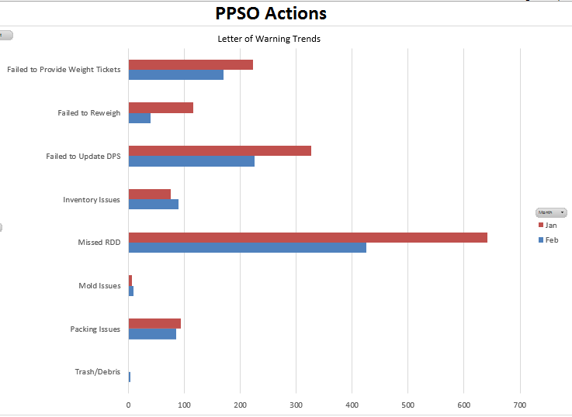
PPSO Punitive Action Letter of Warnings
Notes:
COVER SLIDE GUIDELINES:
Type the title of your briefing where indicated. Titles on the cover slide will be in Arial font, Bolded, size 40 point, centered if possible, see note below.
Type name of briefer in middle & center (if known or if appropriate for the audience)
Type the date of the briefing under briefer name.
NOTE: If the text looks off center or doesn’t fit properly because the title or the name of the briefer is too long, then left justify
GUIDELINES FOR BRIEFING SLIDES:
Slide titles will be in Arial font, Bolded, size 36
Sub-headings, if used will be in Arial font, Bolded, size 24 point
Use the bullet format preset on the slide template.
Text on the slide will be in Arial font, preferred size is 20. Size the font appropriately keeping in mind the audience and the setting for the brief. Text should be black.
CG's NEW GUIDELINES FOR CREATING BRIEFINGS:
Keep them black and white, concise, and free of clutter. CG is a BLUF (Bottom Line Up Front) leader.
Keep future presentations/briefs to no more than five slides.
Highlight a few areas and emphasize your key points/intended takeaways.
Unless a picture serves an explicit purpose, don’t use them.
When briefing, do not read the chart.

Slide 13
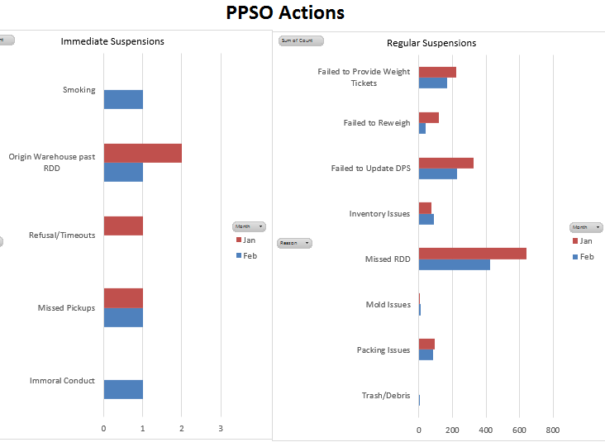
PPSO Letters of Suspension
Notes:
COVER SLIDE GUIDELINES:
Type the title of your briefing where indicated. Titles on the cover slide will be in Arial font, Bolded, size 40 point, centered if possible, see note below.
Type name of briefer in middle & center (if known or if appropriate for the audience)
Type the date of the briefing under briefer name.
NOTE: If the text looks off center or doesn’t fit properly because the title or the name of the briefer is too long, then left justify
GUIDELINES FOR BRIEFING SLIDES:
Slide titles will be in Arial font, Bolded, size 36
Sub-headings, if used will be in Arial font, Bolded, size 24 point
Use the bullet format preset on the slide template.
Text on the slide will be in Arial font, preferred size is 20. Size the font appropriately keeping in mind the audience and the setting for the brief. Text should be black.
CG's NEW GUIDELINES FOR CREATING BRIEFINGS:
Keep them black and white, concise, and free of clutter. CG is a BLUF (Bottom Line Up Front) leader.
Keep future presentations/briefs to no more than five slides.
Highlight a few areas and emphasize your key points/intended takeaways.
Unless a picture serves an explicit purpose, don’t use them.
When briefing, do not read the chart.

Slide 14
Transportation Review Board
TSP may be placed in “non-use” for a definite or indefinite period of time for specific incidents of unsatisfactory service or failure to perform, or a record or trend of satisfactory service or failure to perform in accordance with the terms of negotiated agreements tenders of service, GBLs, service agreements, or governing SDDC rules
Consideration includes whether administrative deficiencies “immediately threaten safety or security” of personal property shipments
Director of PP approves for personal property and NTS TSPs
Consult with OSJA prior to imposing non-use
If TSP disputes findings, a TRB is scheduled within 30 days of non-use imposition
TSP formally notified of basis for TRB
TSP has 14 days to reply, request delay, or notify SDDC of intent to present information in person or by phone. TSP or SDDC may request earlier hearing.
Notes:
Examples of such failures or violations include, but are not limited to, the
following:
(1) Failure to meet ordered packing/pickup dates for personal property shipments.
(2) Selective refusal to accept personal property shipments.
(3) Failure to meet time-in-transit standards agreed upon delivery date and/or required
delivery dates.
(4) Mishandling of personal property shipments (e.g., damaged or missing transportation
seals, improper loading, packing, blocking, or bracing; and improper conduct at an installation or
member’s residence).
(5) Failure to adequately protect DOD shipment(s) from loss and/or damage.
(6) Failure to furnish proper or adequate equipment, facilities or improper substitution of
mode.
(7) Employees who in the performance of DOD-related duties:
(a) Use intemperate, vulgar, or abusive language;
(b) Exhibit evidence of illegal drug use or possession or alcohol use; or,
(c) Engage in other offensive conduct.
(8) Failure to settle loss and damage claims promptly within established timelines.
(9) Failure to comply with applicable federal, state and local laws and regulations
governing the movement of personal property.
(10) Accidents involving DOD-sponsored shipments, serious injury or fatalities, which
indicate a lack of TSP responsibility to perform in a safe manner.
(11) Use of equipment, facilities, or personnel that fail to meet applicable safety and/or
security standards.
(12) Failure to maintain qualification requirements for doing business with the DOD (e.g.,
failure to maintain required liability insurance coverage).
(13) Failure to respond to a SDDC request for financial data, operational data or other
information subject to request under the Tender of Service or similar agreement.
(14) Suspension, debarment, or proposed debarment by any federal agency under the
authority of Federal Acquisition Regulation (FAR) and Defense Federal Acquisition Regulation
Supplement (DFARS).
(15) Indictment or conviction of a criminal offense indicating a lack of business integrity or
honesty that affects the responsibility of the TSP.
(16) Failure to timely provide requested documentation or information, such as Certificates
of Independent Pricing or financial reports, where the failure brings into question the suitability
of the TSP to provide transportation services to the DOD.
(17) Failure of a TSP’s employees, subcontractors or agents to meet requirements for
driving privileges on a DOD installation or other failure to gain timely entry to a DOD
installation (e.g., apprehension, detention or arrest under a warrant or other authority).
(18) A demonstrated lack of business integrity concerning DOD-sponsored shipments by
one or more representatives.
(19) Any other cause or condition of a serious or compelling nature that affects the present
responsibility of a TSP providing transportation services to the DOD.
(20) Non-use action may be taken when authorized by the Deputy Chief of Staff for
Personal Property based on operational or administrative deficiencies so severe as to
immediately threaten safety or security of HHG shipments. Before undertaking non-use action,
officials will consult with the SJA. A TSP in non-use for 6 months or more is required to requalify
through the appropriate SDDC TSP Qualification Program prior to regaining its
eligibility to participate in DOD transportation programs. A TSP may not file rates with SDDC
while in non-use status.
(21) Failure to disclose CFAC, which may lead to prosecution for filing a false official
statement in violation of 18 USC 1001.
(22) The use of abusive, intemperate, disparaging, vulgar language or written
correspondence from a TSP (including all employees), their agent or representative, directed
towards the government, SDDC, SDDC components or DOD components that deal with the
movement and storage of personal property, and the personnel working in those organizations.

Slide 15
Transportation Review Board
Factors considered (include, not limited to):
Investigative reports (police, safety officials, safety/security contractors, Defense Investigative Service, etc.)
TSP’s written and oral presentation(s).
TSP's past performance.
Special services provided by the TSP, which may be unavailable elsewhere.
TSP’s responsiveness to SDDC’s concerns & corrective action taken by TSP
The financial condition of the TSP and the economic impact of disqualification.
Performance history of TSP and affiliates
Determination:
Allow continued participating in DP3 with or without conditions
Disqualify the TSP for a designated period of time.
If the TRB imposes any type of disqualification it must decide whether to suspend for a stated period with or without probationary conditions
Notes:
Examples of such failures or violations include, but are not limited to, the
following:
(1) Failure to meet ordered packing/pickup dates for personal property shipments.
(2) Selective refusal to accept personal property shipments.
(3) Failure to meet time-in-transit standards agreed upon delivery date and/or required
delivery dates.
(4) Mishandling of personal property shipments (e.g., damaged or missing transportation
seals, improper loading, packing, blocking, or bracing; and improper conduct at an installation or
member’s residence).
(5) Failure to adequately protect DOD shipment(s) from loss and/or damage.
(6) Failure to furnish proper or adequate equipment, facilities or improper substitution of
mode.
(7) Employees who in the performance of DOD-related duties:
(a) Use intemperate, vulgar, or abusive language;
(b) Exhibit evidence of illegal drug use or possession or alcohol use; or,
(c) Engage in other offensive conduct.
(8) Failure to settle loss and damage claims promptly within established timelines.
(9) Failure to comply with applicable federal, state and local laws and regulations
governing the movement of personal property.
(10) Accidents involving DOD-sponsored shipments, serious injury or fatalities, which
indicate a lack of TSP responsibility to perform in a safe manner.
(11) Use of equipment, facilities, or personnel that fail to meet applicable safety and/or
security standards.
(12) Failure to maintain qualification requirements for doing business with the DOD (e.g.,
failure to maintain required liability insurance coverage).
(13) Failure to respond to a SDDC request for financial data, operational data or other
information subject to request under the Tender of Service or similar agreement.
(14) Suspension, debarment, or proposed debarment by any federal agency under the
authority of Federal Acquisition Regulation (FAR) and Defense Federal Acquisition Regulation
Supplement (DFARS).
(15) Indictment or conviction of a criminal offense indicating a lack of business integrity or
honesty that affects the responsibility of the TSP.
(16) Failure to timely provide requested documentation or information, such as Certificates
of Independent Pricing or financial reports, where the failure brings into question the suitability
of the TSP to provide transportation services to the DOD.
(17) Failure of a TSP’s employees, subcontractors or agents to meet requirements for
driving privileges on a DOD installation or other failure to gain timely entry to a DOD
installation (e.g., apprehension, detention or arrest under a warrant or other authority).
(18) A demonstrated lack of business integrity concerning DOD-sponsored shipments by
one or more representatives.
(19) Any other cause or condition of a serious or compelling nature that affects the present
responsibility of a TSP providing transportation services to the DOD.
(20) Non-use action may be taken when authorized by the Deputy Chief of Staff for
Personal Property based on operational or administrative deficiencies so severe as to
immediately threaten safety or security of HHG shipments. Before undertaking non-use action,
officials will consult with the SJA. A TSP in non-use for 6 months or more is required to requalify
through the appropriate SDDC TSP Qualification Program prior to regaining its
eligibility to participate in DOD transportation programs. A TSP may not file rates with SDDC
while in non-use status.
(21) Failure to disclose CFAC, which may lead to prosecution for filing a false official
statement in violation of 18 USC 1001.
(22) The use of abusive, intemperate, disparaging, vulgar language or written
correspondence from a TSP (including all employees), their agent or representative, directed
towards the government, SDDC, SDDC components or DOD components that deal with the
movement and storage of personal property, and the personnel working in those organizations.

Slide 16
Transportation Review Board
Board Composition:
Three (3) voting members (must be in grade of O-4+ or GS-13+)
Highest graded individual on panel is Chairperson (must be O-5 or GS-14, minimum)
Appeals:
TSPs may appeal a TRB decision within 15 calendar days from receipt of decision letter
An appeal will fully document the reasons for requesting relief, which may include the submission of new material or bona fide change of management
The disqualification period may be terminated, suspended, or reduced upon presentation of evidence that the causes and conditions resulting in the initial disqualification have been eliminated or corrected, or upon the execution of an agreement with the TSP outlining the conditions upon which the original TRB decision is being modified.
An appeal of a personal property or NTS TRB will be forwarded to the Chief of Staff, HQ Military Surface Deployment and Distribution Command, 1 Soldier Way, Scott AFB, IL 62225
Appeals will be independently reviewed and processed by personnel not substantially involved in the initial TRB decision.
Notes:
Requirement is in DTR Part IV Chapter 401 Para D.10.t
“Schedule a personal property Staff Assistance Visit (SAV) for each Personal Property Shipping Office (PPSO) within their Area of Responsibility (AOR) once every two years. Supported Personal Property Processing Offices (PPPO) must be included in the SAV. The purpose of the SAV is to assist the PPSO in executing personal property traffic management program initiatives and evaluate program effectiveness. Visits must be coordinated with the Service/Agency HQ or major command to avoid duplication of effort.
(1) SAV dates must be coordinated with the PPSO at least 45 days in advance, followed up in writing with information copies to the Service/Agency HQ or major command.
(2) The SAV representative must prepare a report of visit within 30 days following completion of the SAV addressed to the PPSO/PPPO visited, with information copy to the Service/Agency HQ or major command.

Slide 17
Transportation Review Board
Bottom Line:
Intended to be a transparent “due process” closely coordinated with our Staff Judge Advocate with the best interests of the Service Member (past and future) at the forefront
Notes:
Requirement is in DTR Part IV Chapter 401 Para D.10.t
“Schedule a personal property Staff Assistance Visit (SAV) for each Personal Property Shipping Office (PPSO) within their Area of Responsibility (AOR) once every two years. Supported Personal Property Processing Offices (PPPO) must be included in the SAV. The purpose of the SAV is to assist the PPSO in executing personal property traffic management program initiatives and evaluate program effectiveness. Visits must be coordinated with the Service/Agency HQ or major command to avoid duplication of effort.
(1) SAV dates must be coordinated with the PPSO at least 45 days in advance, followed up in writing with information copies to the Service/Agency HQ or major command.
(2) The SAV representative must prepare a report of visit within 30 days following completion of the SAV addressed to the PPSO/PPPO visited, with information copy to the Service/Agency HQ or major command.

Slide 18
Staff Assistance Visits
Opportunity to find best practices and deliver value to Services and DP3
DTR Chp 401 Par D.10.t –every 2 years at PPSOs
Standardize & educate
SDDC updated checklist included Services operational feedback
Added new questions across multiple areas of DP3
Plan to integrate satellite PPPO offices
Restarted March 2016 at Det 3 (JPPSO-South Central), April at JPPSO-MA, TBD at JPPSO-SW
Intent is to leverage Services Operational offices (PPA, APPLE, GLS) to provide coordinated SAV team
Notes:
Requirement is in DTR Part IV Chapter 401 Para D.10.t
“Schedule a personal property Staff Assistance Visit (SAV) for each Personal Property Shipping Office (PPSO) within their Area of Responsibility (AOR) once every two years. Supported Personal Property Processing Offices (PPPO) must be included in the SAV. The purpose of the SAV is to assist the PPSO in executing personal property traffic management program initiatives and evaluate program effectiveness. Visits must be coordinated with the Service/Agency HQ or major command to avoid duplication of effort.
(1) SAV dates must be coordinated with the PPSO at least 45 days in advance, followed up in writing with information copies to the Service/Agency HQ or major command.
(2) The SAV representative must prepare a report of visit within 30 days following completion of the SAV addressed to the PPSO/PPPO visited, with information copy to the Service/Agency HQ or major command.

Slide 19
Summary
WAY AHEAD
Continue adding stability to program
Educate, communicate, and monitor quality of TSP performance
Transition remaining TOPS legacy functions to DPS (Phase III-NTS, and DPM Shipments)
Leverage SDDC CG process improvement initiative
Understanding Open Season
Communications/engagement
Claims program
TAKE AWAYS
Business rules and system synchronization
No organic assets, rely heavily on industry
Support all Services worldwide
>500K shipments/year
>72,443 POVs (FY15)
Peak season: 40% of all moves
PP management is a worldwide endeavor; majority of staff now centralized
Notes:
Code J/T shipments utilize AMC for the over ocean portion, industry for pack/unpack
30% loss of drivers, avg age 55+,
Learn to say no
TSPs on board with quality based program

Slide 20
QUESTIONS

